Slide 1
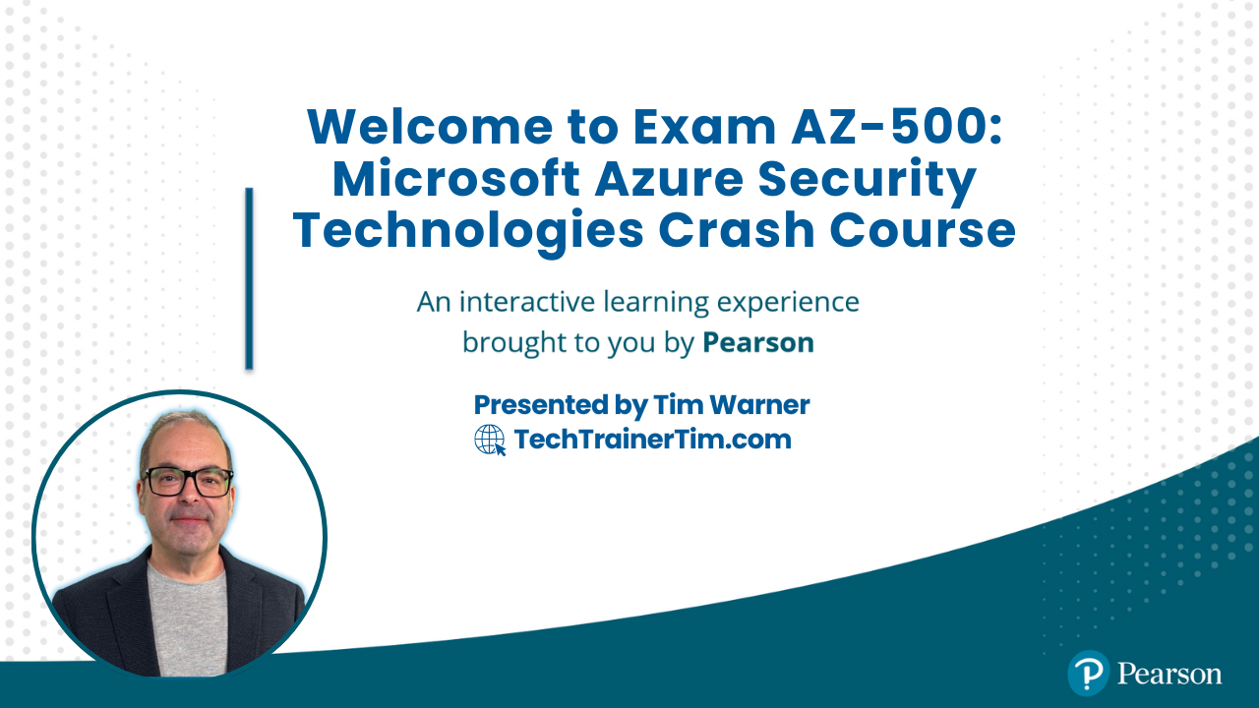

Exam AZ-500: Microsoft Azure Security Technologies Crash Course
Tim Warner

Slide 2
Tim Warner
Based in Nashville, TN, US
Central Time Zone
28-year MCT, 6-year MVP
Contact: TechTrainerTim.com

Slide 3
Course Materials
timw.info/az500

Slide 4
Learning Goals
Introduction
Cover the exam's objective domain (OD) as concisely as possible
Transmit winning strategies for clearing the certification

Slide 5
Setting Expectations
Let's avoid slide show fatigue
We'll learn by doing – at least 80 percent demo
Case study/scenario approach
I’m here to answer your questions – take advantage of this!
Use the Q&A panel, please!

Slide 6
Break Schedule (Central Time Zone)
09:00 am - Start Segment 1
10:00 am - 9-min break - Start Segment 2
11:00 pm - 9-min break - Start Segment 3
12:00 pm - 9-min break - Start Segment 4
01:00 pm - 9-min break - Start Segment 5
02:00 pm - Finish

Slide 7

Session Recordings

Slide 8

Session Recordings

Slide 9


Mobile Browser: learning.oreilly.com

Slide 10



O'Reilly Mobile App

Slide 11
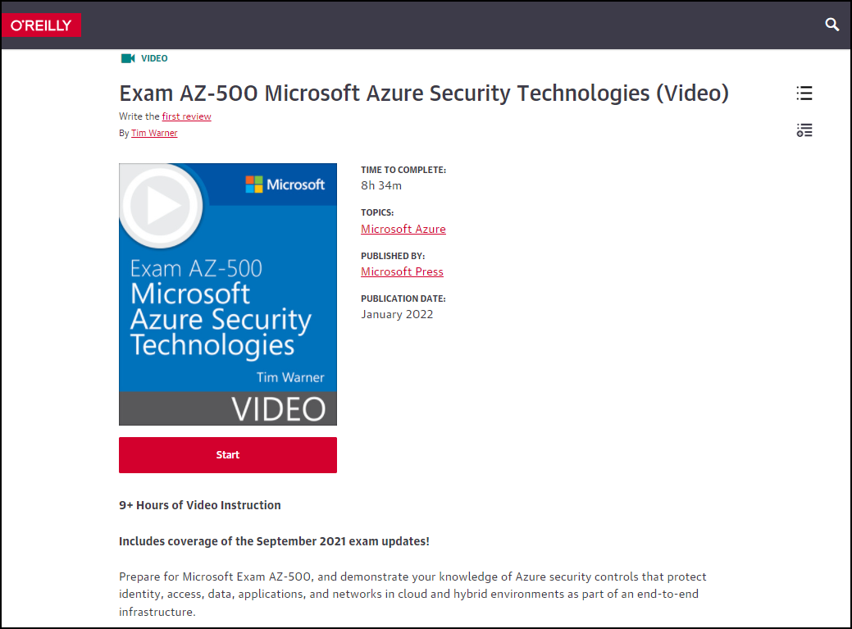
AZ-500 Video Course 2e (MS Press)
timw.info/msp500

Slide 12
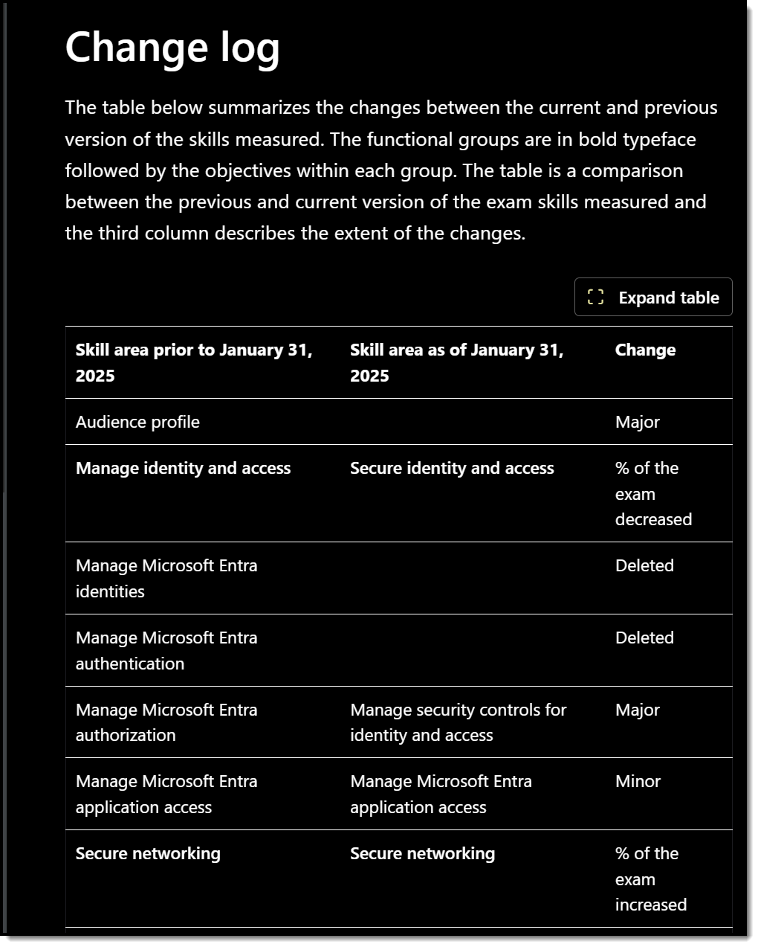
Exam AZ-500 Latest Update
January 31, 2025
Major content update

Slide 13
Certification Renewal
Associate and Expert certs are valid for one year
Credential will always be on your MS transcript
At six-month mark you’ll be asked to renew
Free online assessment at Microsoft Learn
Renewal extends your certification for 365 from original achievement date

Slide 14
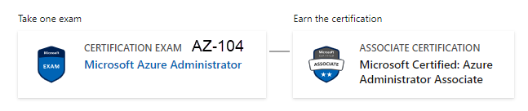
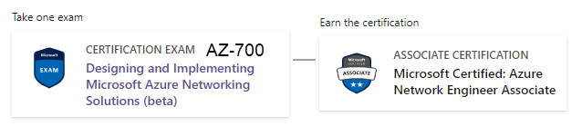

Related Certifications

Slide 15
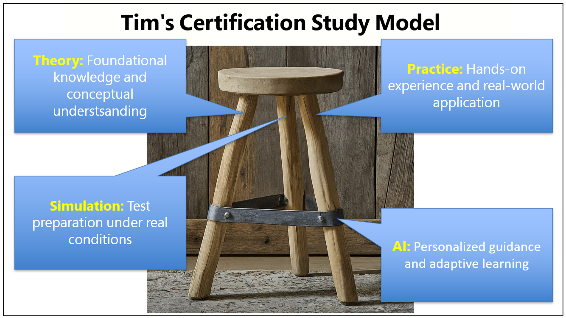
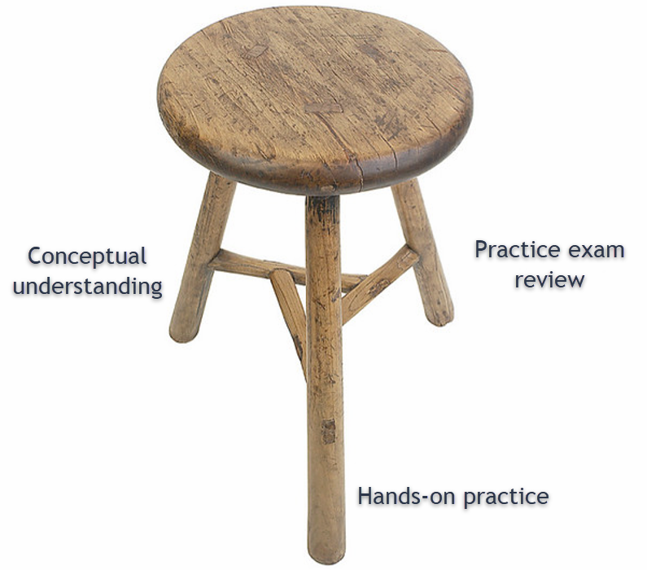
Tim's Certification Study Model

Slide 16
Thank you!
Course materials: timw.info/az500
Contact: TechTrainerTim.com

Slide 17
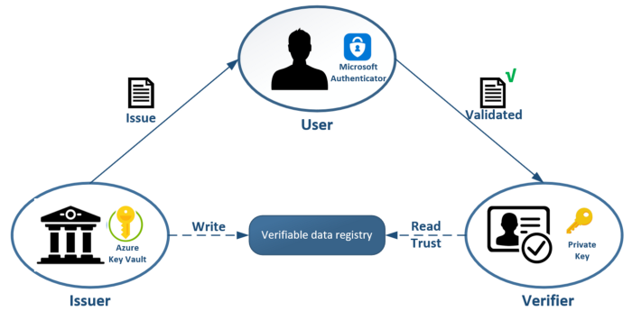
Entra Verified ID

Slide 18
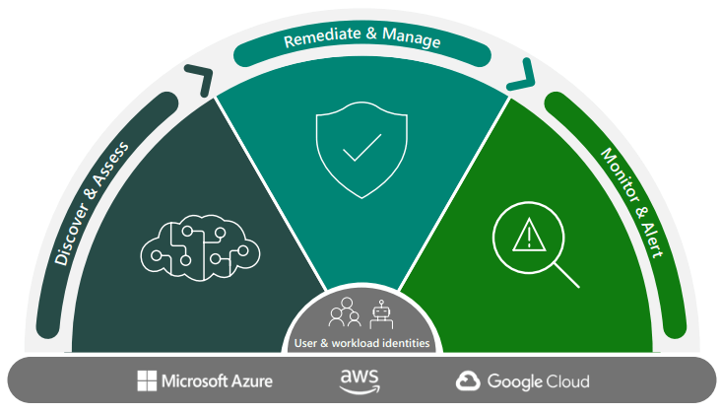
Entra Permissions Management

Slide 19
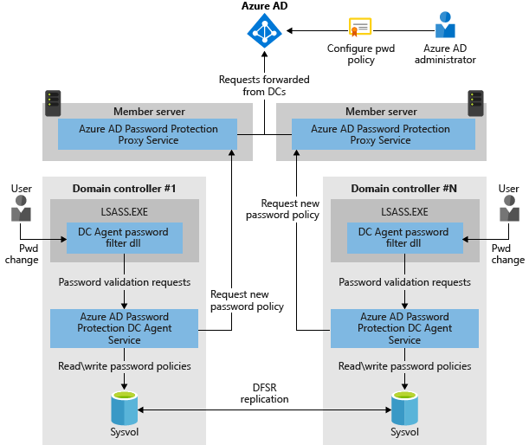
Azure AD Password Protection

Slide 20
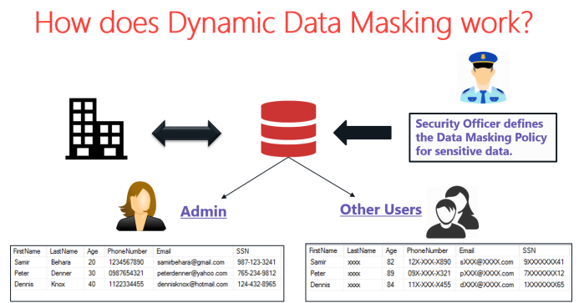
Dynamic Data Masking (DDM)

Slide 21
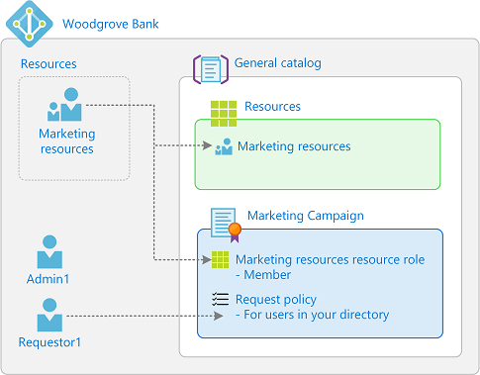
Entitlement Management

Slide 23
Manage Identity and Access

Slide 24
AAA Model
Authentication
Identity verification
Authorization
Access scope
Accounting
Successful and failed AuthN and AuthZ attempts

Slide 25
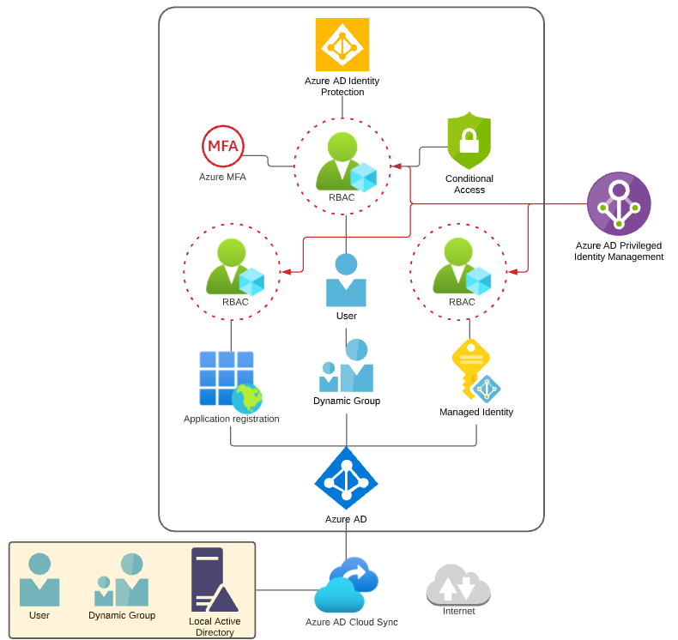
Identity and Access Scenario

Slide 26

Tenant vs. Subscription

Slide 27

Hybrid Identity

Slide 28

Azure Management Scopes
/ Tenant Root

Slide 29
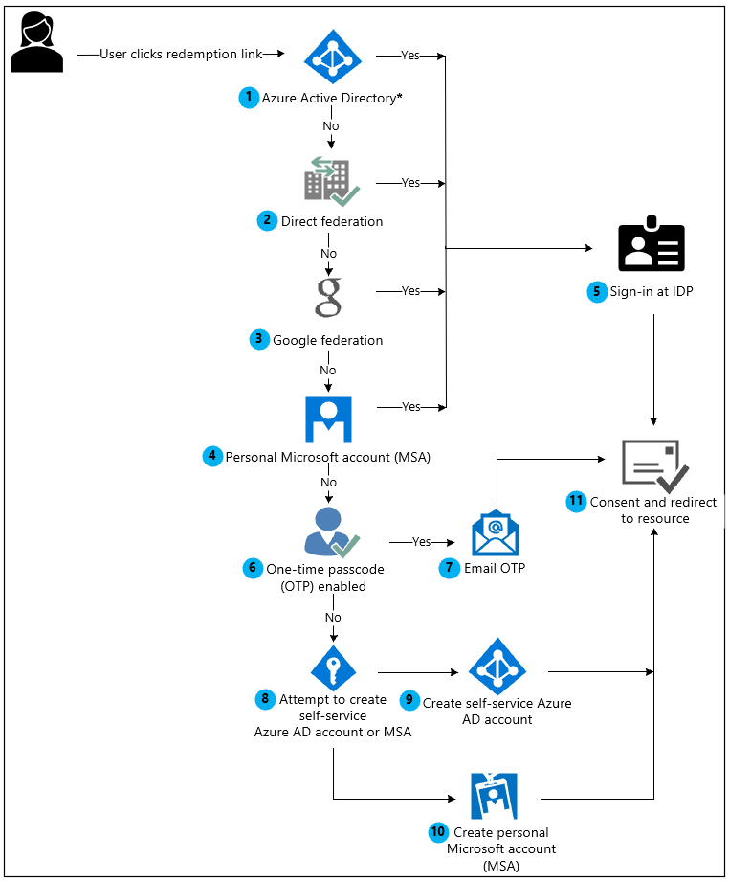
Azure AD B2B Collaboration

Slide 30
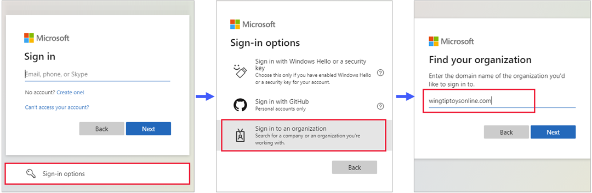
Azure AD B2B Collaboration

Slide 31
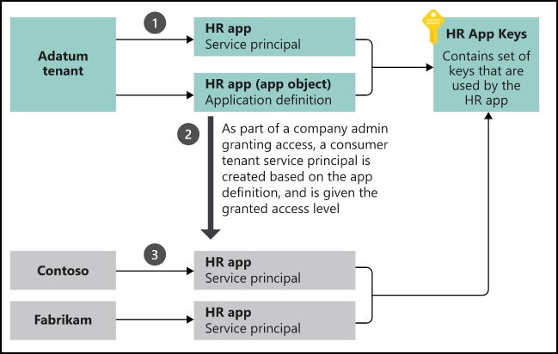
App Registrations & Service Principals

Slide 32


Azure AD B2C

Slide 33

Azure AD Domain Services

Slide 34
Azure AD Connect

Slide 35

Passthrough Authentication

Slide 36

ADFS Federation

Slide 37
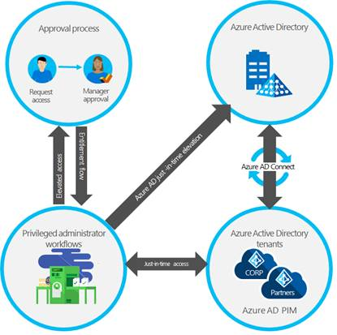
Azure AD PIM

Slide 38
Implement Platform Protection

Slide 39
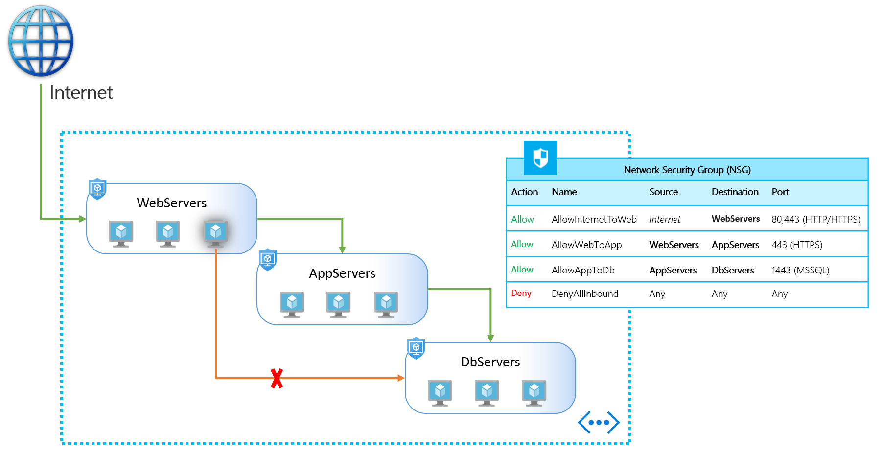
NSGs and ASGs

Slide 40

Multi-Region High Availability

Slide 41

Multi-Region High Availability

Slide 42
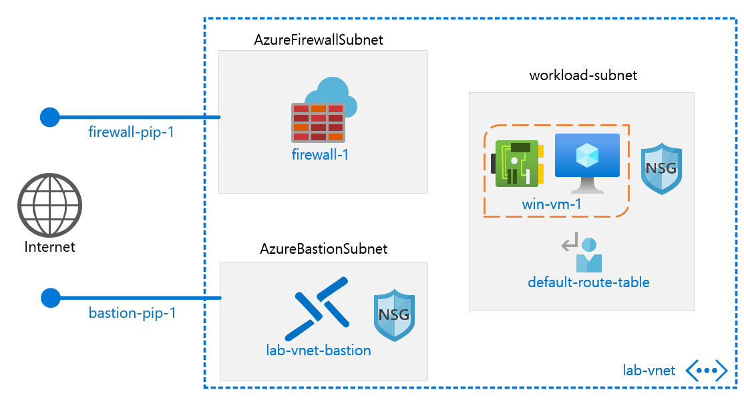
Azure Firewall

Slide 43
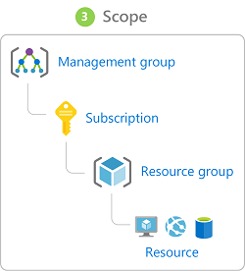
Management Scopes
/ Tenant Root

Slide 44

Service endpoints

Slide 45
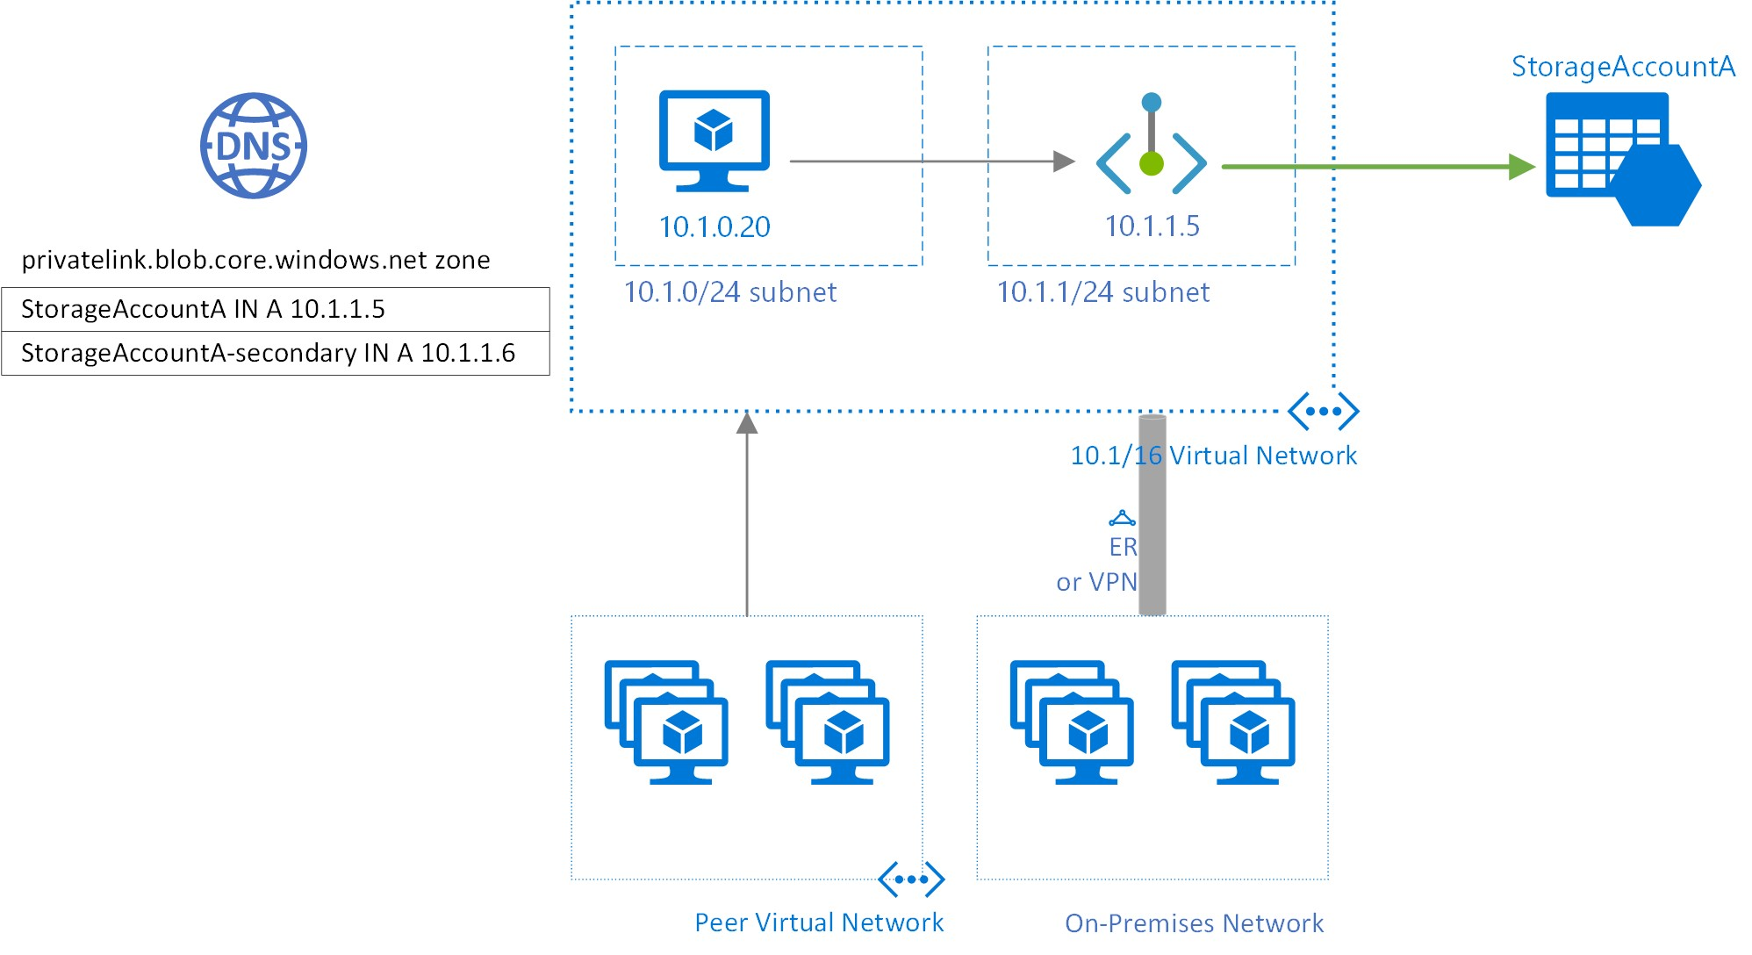
Private endpoints

Slide 46
Compute and Networking

Slide 47
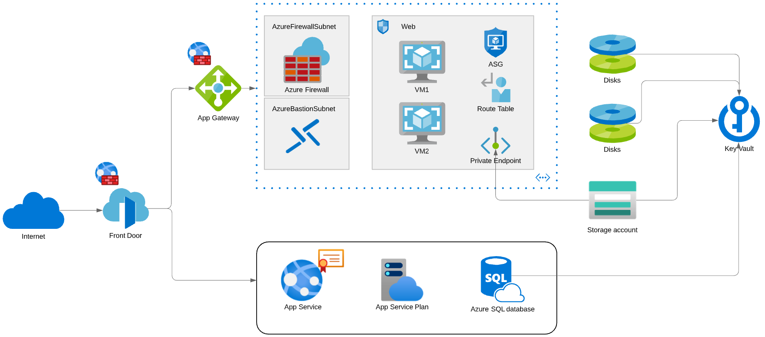
Compute and Networking Scenario

Slide 48
Manage Security Operations

Slide 49
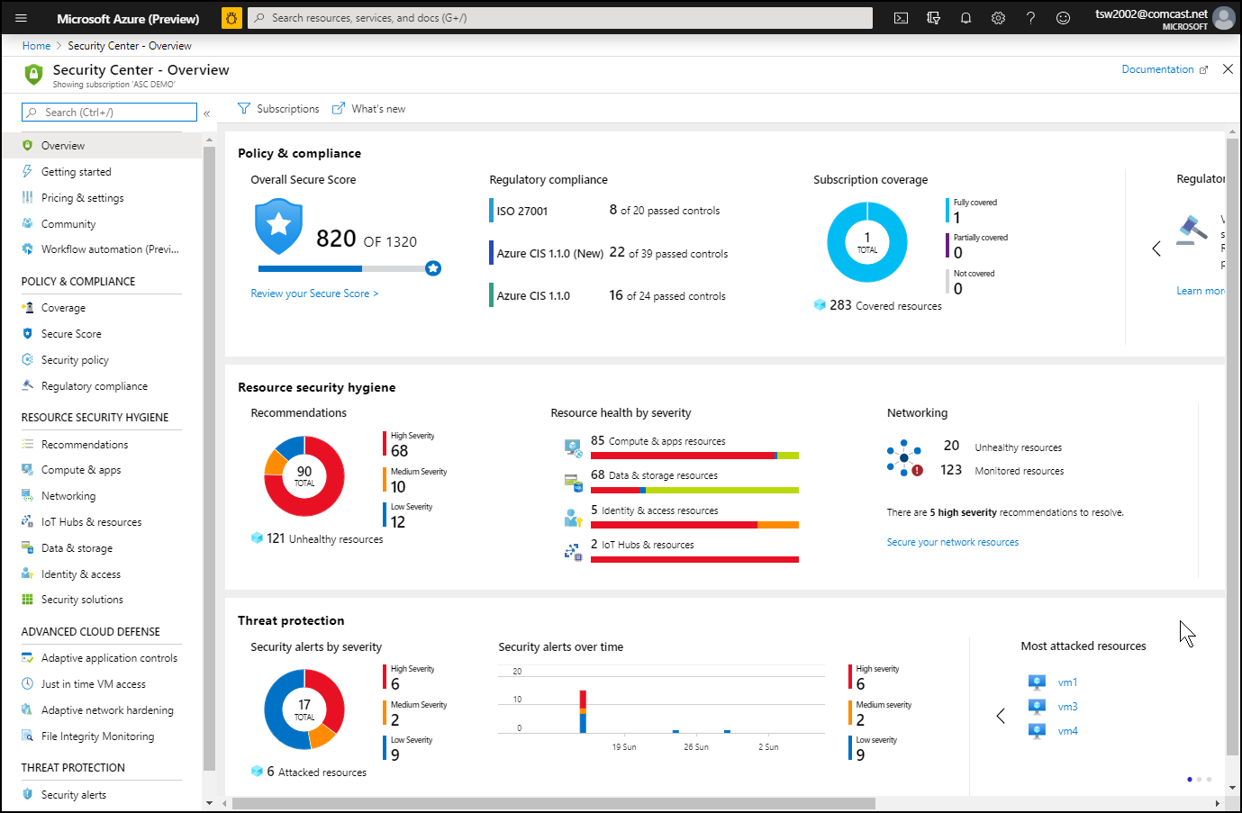
Azure Security Center

Slide 50
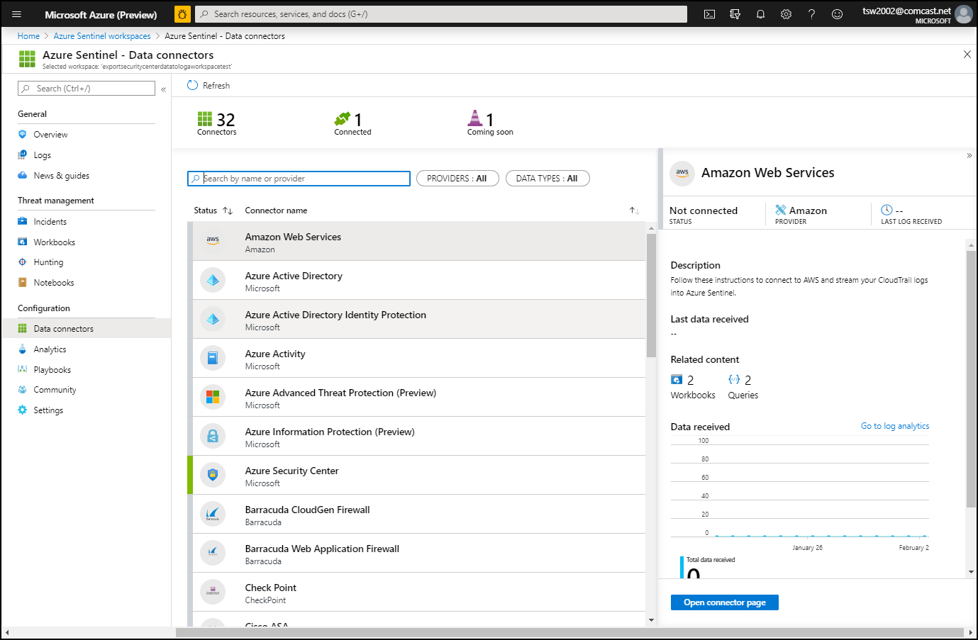
Azure Sentinel

Slide 51
Secure Data and Applications

Slide 52
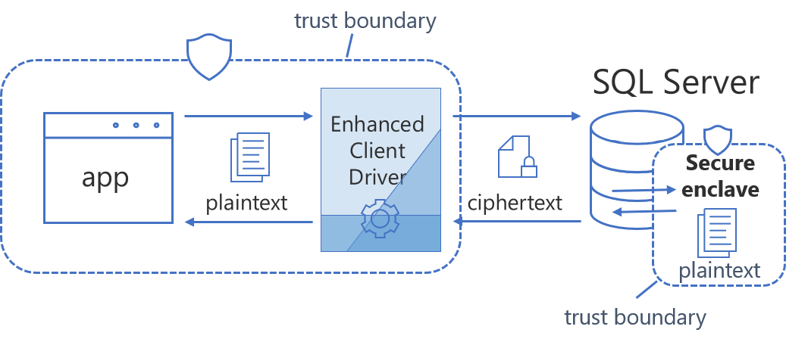
Always Encrypted

Slide 53
Security Operations

Slide 54
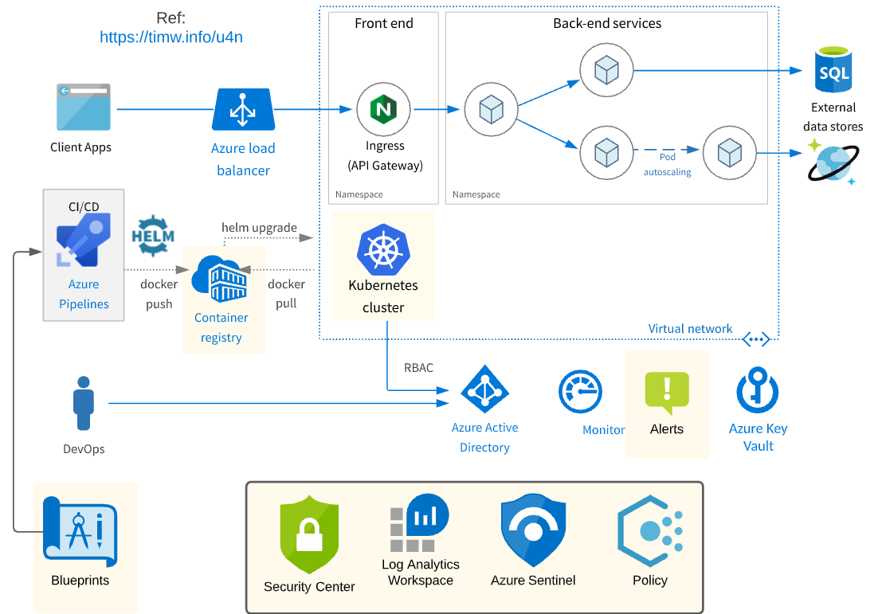
Security Operations Scenario

Slide 55
Exam AZ-500 Item Types

Slide 56

Single Answer Multiple Choice

Slide 57

Multiple Answer Multiple Choice

Slide 58
Repeated Scenario
You need to move an Azure VM to another hardware host.
Solution: You redeploy the VM.
Does this solution meet the goal?
Yes
No

Slide 59
Repeated Scenario
You need to move an Azure VM to another hardware host.
Solution: You enable boot diagnostics.
Does this solution meet the goal?
Yes
No

Slide 60

Select and Place

Slide 61

Build List and Reorder

Slide 62

Active Screen

Slide 63

Case Study

Slide 64






Performance-Based Testing

Slide 65
Microsoft Online Testing

Slide 66
Microsoft Online Testing Process
timw.info/online

Slide 67

Microsoft Online Testing Process

Slide 68

Microsoft Online Testing Process

Slide 69

Microsoft Online Testing Process

Slide 70

Microsoft Online Testing Process

Slide 71

Microsoft Online Testing Process

Slide 72

Microsoft Online Testing Process

Slide 73

Microsoft Online Testing Process

Slide 74
AZ-500 Exam Strategy
Focus your skills accordingly:
60 percent Azure portal
20 percent Azure PowerShell
10 percent Azure CLI
10 percent KQL
Azure AD PIM all day long
Expect performance-based labs, but be happy if you don't see 'em

Slide 75
Parting Advice
Check out my YouTube (timw.info)
Online testing
Cert item strategy
AZ-500 study guide
Invest in Whizlabs or MeasureUp
Register for your exam ASAP!

Slide 76
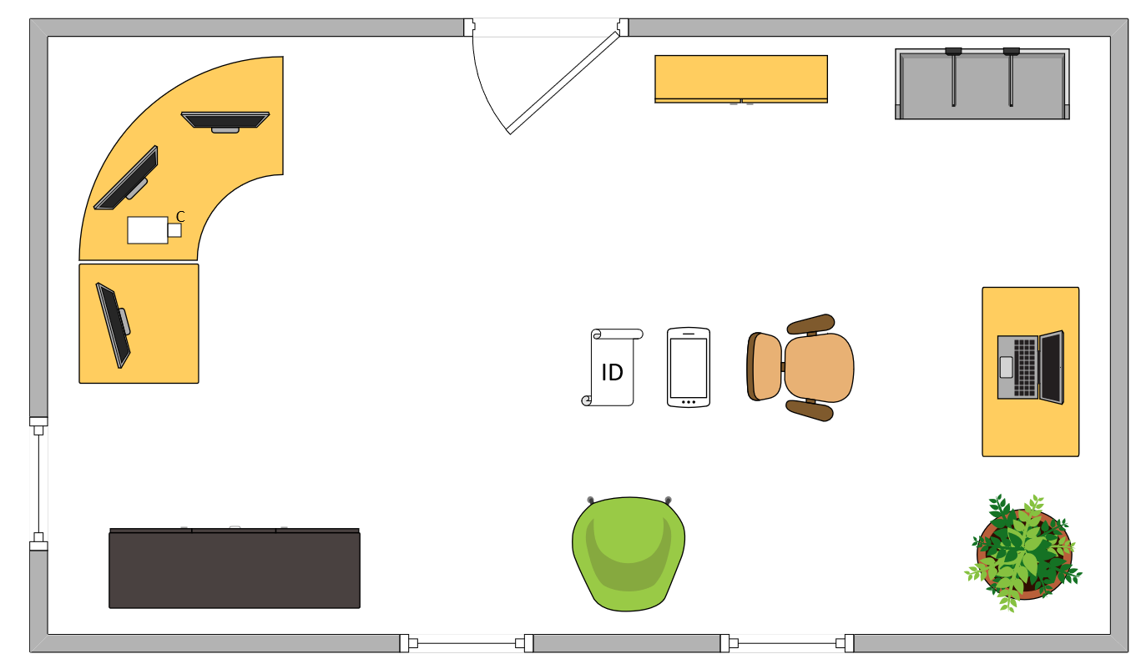

Tim’s Ideal Testing Room
No interruptions or bio breaks
Cover monitors and cameras
Pull back for environment photos
Clear table with laptop

Slide 77
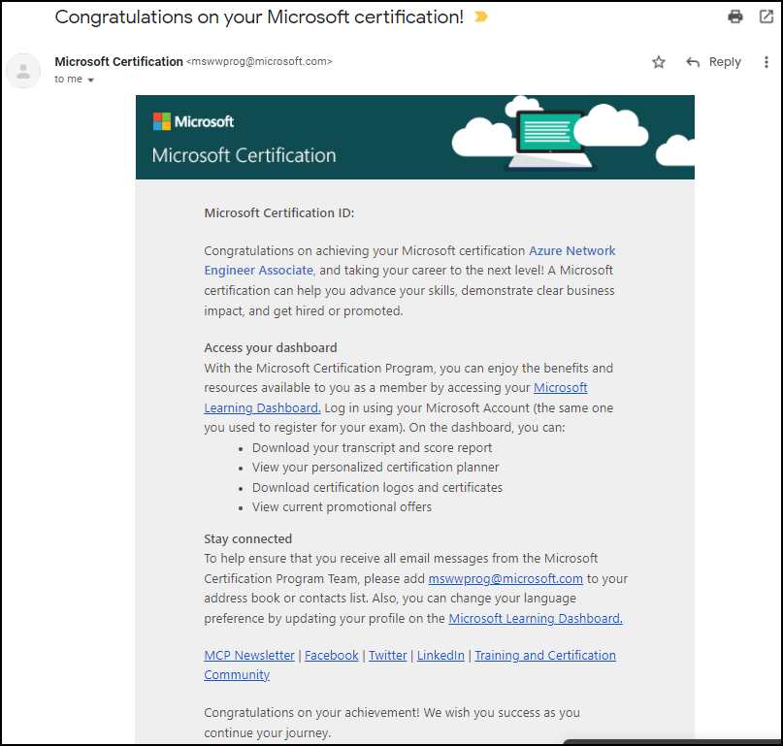
Congratulations!

Slide 78
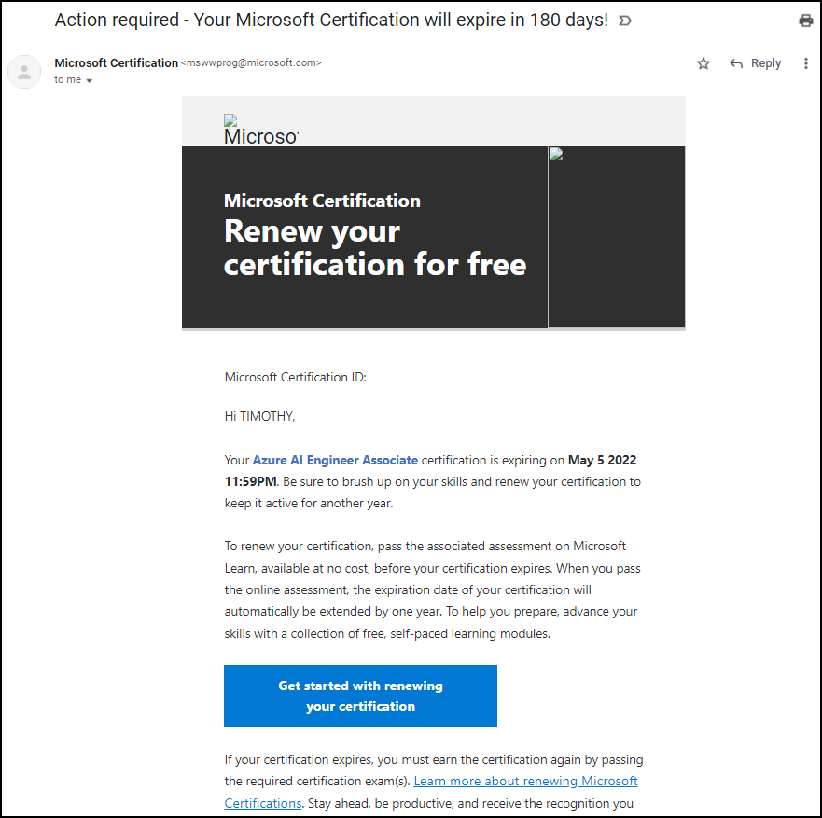
Certification Renewal

